Slide 1
Jenson Decors
Made By
Zaviyar (ppt, users/developers guide, web development)
Rohaan(web development)
Alyan(leading, web development)
Faraz(web development)

Slide 2
Our Introduction
About Jenson Decors: Jenson Decors is a modern interior design and décor company dedicated to transforming ordinary spaces into elegant, functional, and personalized environments. Founded with a passion for creativity and excellence, Jenson Decors has grown into a trusted name in the world of interior design and home aesthetics.
Our Mission: To deliver high-quality, innovative, and sustainable design solutions that enhance the way people live and work.
Our Vision: To become a leading interior décor brand known for timeless designs, customer satisfaction, and craftsmanship that blends art with comfort.
Core Values:
Creativity: Turning ideas into unique, visually stunning designs.
Quality: Using premium materials and skilled workmanship.
Sustainability: Designing spaces with care for the environment.
Customer Focus: Building long-term relationships through trust and satisfaction.

Slide 3
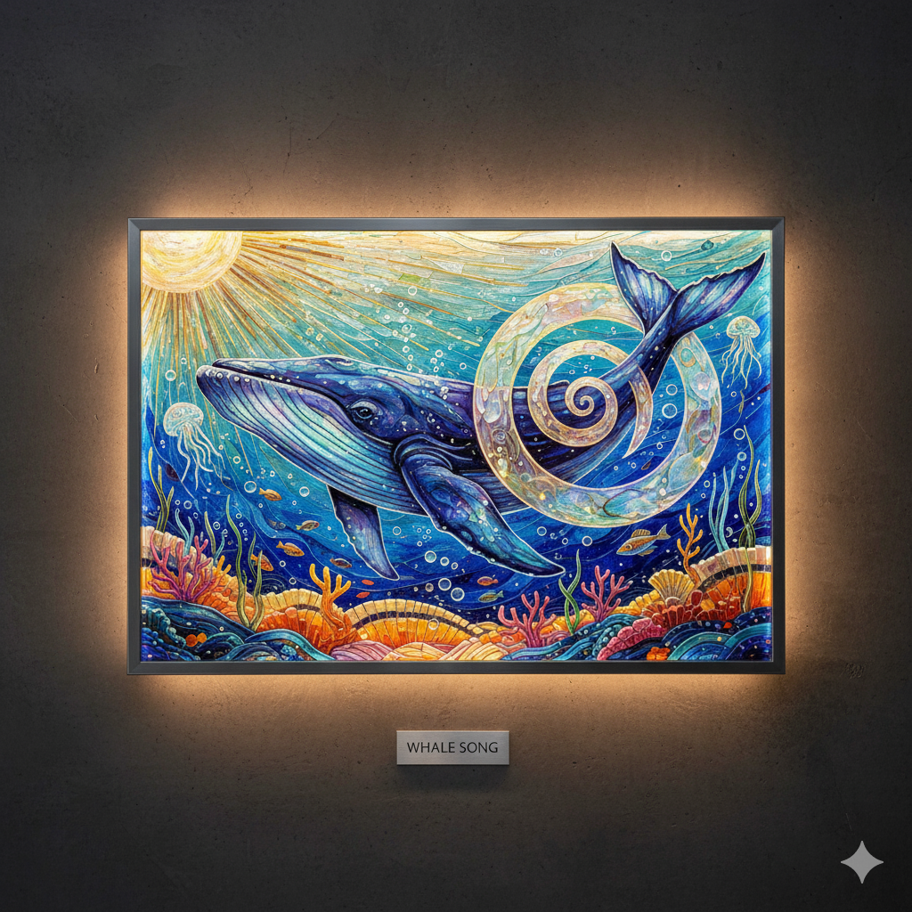
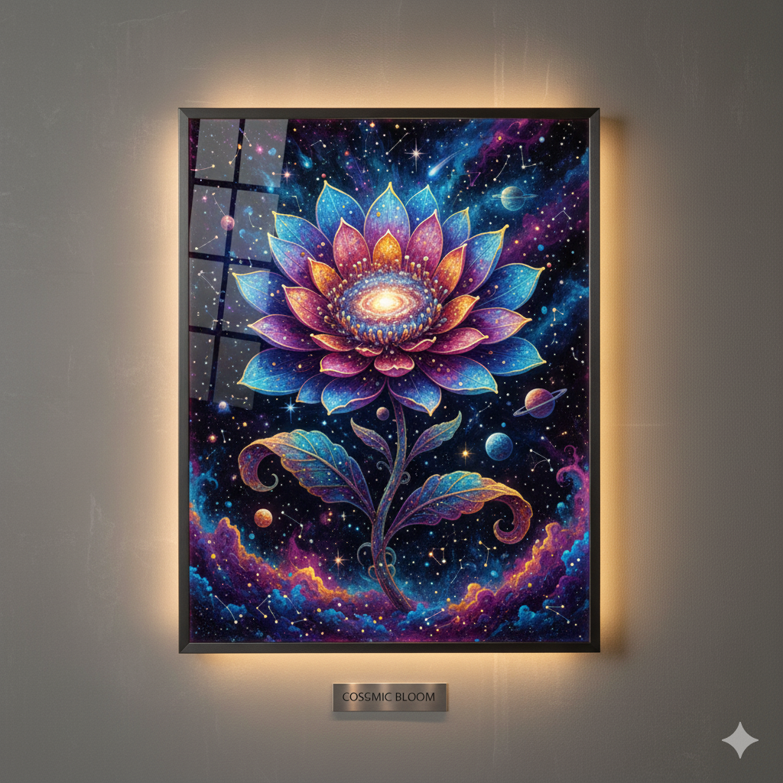
Our Arts

Slide 4
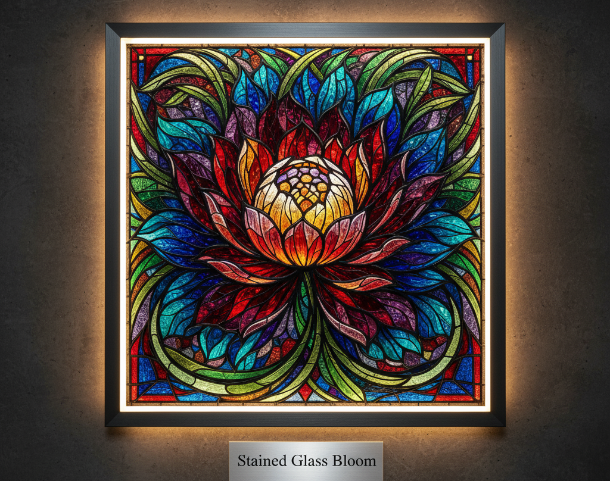
What We Offer
“We Specialize In design spaces that reflect your personality and make every corner stand out”
Stylish Home Décor – We make homes look modern, cozy, and beautiful
Event Decorations – From weddings to parties, we make every event look amazing.
Makeovers & Renovations – Give your space a fresh and trendy new look.
Lighting & Color Ideas – Perfect colors and lights to make your rooms stand out.
3D Design Previews – See your design before we make it real.

Slide 5
Materials And Styles
“At Jenson Decors, we believe that the right materials and design style define the personality of every space. Our approach combines luxury, comfort, and durability — ensuring each design is as long-lasting as it is beautiful.”
Materials We Use
Wood & Veneer: For warmth, elegance, and natural texture in furniture and flooring.
Marble & Stone: Adds a touch of luxury and timeless sophistication.
Glass & Mirrors: Enhances openness and light within spaces.
Metal Accents (Gold, Brass, Chrome): For a refined, modern finish.
Fabrics & Upholstery: Soft textures and rich colors for comfort and character.
Eco-friendly Materials: Bamboo, recycled wood, and low-VOC paints to support sustainable design.

Slide 6
Our Philosophy
“Our philosophy is built around creativity, comfort, and timeless elegance. We strive to design interiors that not only look beautiful but also reflect the personality and lifestyle of the people who live or work in them.”
We focus on:
Simplicity with sophistication – blending modern trends with classic charm.
Sustainability – using eco-friendly materials and efficient design practices.
Attention to detail – ensuring every corner contributes to the overall harmony of the space.
Client-centered design – listening to our clients’ needs and turning their vision into reality.
In every project, our goal is to transform ordinary spaces into extraordinary experiences — where aesthetics meet functionality.

Slide 7
Design Styles We Offer
Modern Minimalist: Clean lines, neutral tones, and functional elegance.
Classic Luxury: Ornate detailing, rich materials, and timeless appeal.
Contemporary: Fresh trends with bold contrasts and sleek forms.
Bohemian Chic: Creative layering, natural elements, and artistic touches.
Industrial: Raw materials like brick, metal, and concrete for a bold aesthetic.
Scandinavian: Light, cozy, and functional spaces focused on simplicity.
Our Signature Style
“A seamless blend of modern sophistication and personalized comfort — creating interiors that reflect both aesthetic beauty and practical living.”

Slide 8
Customer Testimonials & Achievements
At Jenson Decors, our clients are at the heart of everything we do. Their satisfaction and trust inspire us to keep delivering excellence. Here are a few words from our happy customers:
“Jenson Decors completely transformed our home. Every detail was handled with perfection and care.” — Sarah Malik, Homeowner
“Their team understood our vision better than we did ourselves. Our office looks stunning and professional.” — Ahmed Khan, Business Owner
“From design to execution, everything was smooth and on time. Highly recommend their service!” — Fatima Noor, Interior Enthusiast

Slide 9
Contact us
Contains details to our company
Contains our G-mail in which you can message us about personal designs which you want to make
We also use our G-mail to inform you about your products delivery
You can personally order too with our contact number

Slide 10
Sign In
Allows a user to make an account and start shopping
While making the account there are certain requirements:
Email Requirements:
- Must start and end with a letter or number.
- Dots, hyphens, and underscores may appear inside but not at the beginning or end.
- After the (@), domain structure must be valid.
Password Requirements:
- 10–20 alphanumeric characters.
- Must start and end with a letter or number.

Slide 11
Future Goals
Future Goals:
Jenson Decors aims to strengthen its position in the interior design industry through focused and strategic growth. Our key objectives include:
Service Expansion Gradually extending our design and décor services to selected major cities.
Enhanced Client Experience Introducing improved consultation methods, including 3D previews and personalized design plans.
Sustainable Practices Increasing the use of environmentally responsible materials and energy-efficient design solutions.

Slide 12
Conclusion
Jenson Decors remains committed to delivering refined, high-quality interior design solutions. Our work is guided by professionalism, innovation, and a deep understanding of our clients’ needs. We strive to continue creating spaces that are functional, elegant, and aligned with modern living standards.
Thank you for your time.

